Slide 1
DELIRIUM DEMENTIA AND DEPRESSION
Assessment, Management & Prevention

Slide 2
DEMENTIA
Characterized by:
Gradual
&
Progressive cognitive decline
Memory impairment
Cognitive disturbances:
Language disturbance
Impaired ability to carry out motor activities despite intact motor function
Inability to recognize or identify objects despite intact sensory function
Disturbance in executive functioning (e.g., planning, organizing, sequencing, abstracting)
Notes:
Eventually leading to a significant inability to maintain occupational and social performance

Slide 3
DEMENTIA
Frontotemporal
Slow onset
Course: 2-7 years
Lewy Body
Slow onset
Increasing rigidity, decreasing mobility
Vascular
Alzheimer
Insidious (1-2 years ) before diagnosis
Gradual and progressing over years
Usually 8-10 years, but variable
Sudden onset
Step-like progression
Course:variable
Dependent on area affected in the brain
More rapid than Alzheimer
More common in male
Rapid, fluctuating but progressive
Course~5years
Parkinsonism
(RNAOa, 2010)

Slide 4
DEPRESSION
Characterized by:
Symptoms present for two week:
depressed mood
loss of interest or pleasure
Change from previous level of functioning
Accompanying symptoms:
Significant weight loss/gain
Insomnia/hypersomnia
Psychomotor agitation/retardation
Fatigue/loss of energy
Feelings of worthlessness
Diminished ability to think and concentrate
Recurrent thoughts of death or suicidal ideations

Slide 5
DEPRESSION
Elderly: report more somatic or physical symptoms rather than depressed mood
The most troubling outcome of depression is elder suicide, and older adults have the highest risk of suicide rates of any age group.
(RNAOb, 2010)

Slide 6
DELIRIUM
Characterized by :
Temporary
Acute
&
Sudden onset
Fluctuating symptoms:
Cognitive impairment
Disorganized thinking
Disturbances in attention
Decline in level of consciousness

Slide 7
DELIRIUM
Under-recognized by nurses, physicians, allied health.
Prevalence:
10-15% elderly medical patient at time of admission
10-30% elderly admitted in hospital
10-15% elderly surgical patients
50% elderly with hip fracture.
(RNAOb, 2010)

Slide 8
DELIRIUM
Associated with :
Mortality rates of 25-33 %,
Increased length of hospital stay
Increased intensity of nursing care
Greater healthcare costs
(RNAOb, 2010)

Slide 9
DELIRIUM
Hyper-active
Hypo-active
Agitation
Picking/pacing- non-purposeful, repetitive movement
Vivid hallucinations
Irritability
Aggression-involving verbal behavior
Inactive
Psychomotor retardation
Diminished awareness
Higher likelihood of being unrecognized
Mixed delirium : mixture of both hyperactive & hypoactive delirium

Slide 10
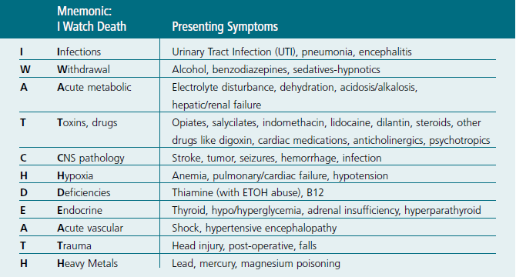
DELIRIUM: Precipitating Factors
(RNAOb, 2010, p. 37)

Slide 11
3D’s
The clinical features of the 3Ds can occur alone, or may overlap or frequently coexist in the older adult, therefore caregivers need to seek evidence to identify their presence.

Slide 12
Differentiating the 3D’s
Feature | Delirium/Acute Confusion | Dementia | Depression
Onset | Acute/subacute depends on cause, often at twilight | Chronic, generally insidious, depends on cause | Coincides with life changes, often abrupt
Course | Short, diurnal fluctuations in symptoms; worse at night in the dark & on awakening | Long, on diurnal effects, symptoms progressive yet relatively stable over time | Diurnal effects, typically worse in the morning; situational fluctuations but less than acute confusion
Progression | Abrupt | Slow but even | Variable, rapid-slow but uneven
Duration | Hours to less than 1 month, seldom longer | Months to years | At least 2 weeks, but can be several months to years
Awareness | Reduced | Clear | Clear

Slide 13
Differentiating the 3D’s
Feature | Delirium/Acute Confusion | Dementia | Depression
Attention | Impaired, fluctuates | Generally normal | Minimal impairment but distractible
Orientation | Fluctuates in severity, generally impaired | May be impaired | Selective disorientation
Memory | Recent & immediate impaired | Recent & remote impaired | Selective or patchy impairment, “islands” of intact memory
Thinking | Disorganized, distorted, fragmented, slow or accelerated incoherent | Difficulty with abstraction, thoughts impoverished, make poor judgments, words difficult to find | Intact but with themes of hopelessness, helplessness or self-deprecation
Perception | Distorted; illusions, delusions & hallucinations, difficulty distinguishing between reality & misperceptions | Misperceptions often absent | Intact; delusions & hallucinations absent except in severe cases.

Slide 14
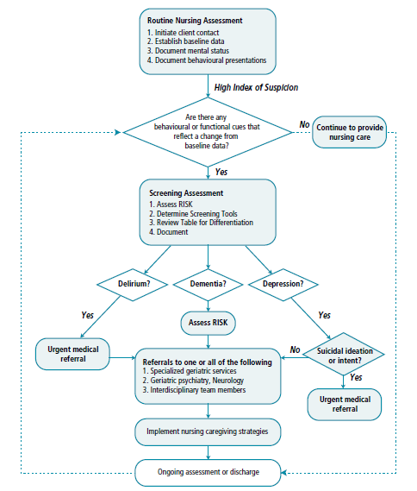

Slide 15
Clinical Assessment
Obtain Collateral history
Assess for delirium
Assess for dementia
Assess for depression
Obtain health history to identify possible causes & risk factors of delirium, dementia, depression
Review medications
Assess test results
Assess Risk
Use an Interdisciplinary Team Approach
Make a referral if necessary
Continue ongoing assessment
* The assessment sequence of what you do when will vary with each case

Slide 16
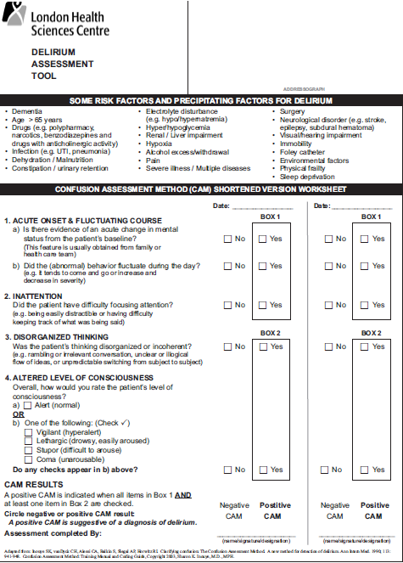
Confusion Assessment Method (CAM)tool

Slide 17
Delirium- Case Study
1500hrs
An 84-year-old woman is transferred from a long-term care facility to the hospital ED for evaluation of hip fracture.
Transfer report reveals that patient slipped on her way to bathroom and feel, landing on her right side, striking her right hip. Patient had been feeling weak and has drawn out of group activities from past 1 week.
Patient’s vitals are as follow:
BP: 147/93, T-37.3, RR-22, O2 sat: 95%, HR-89
Pt has a strong urine odour and is incontinent of urine. The right thigh and hip were extremely tender and bruised. The right leg is shortened and externally rotated.

Slide 18
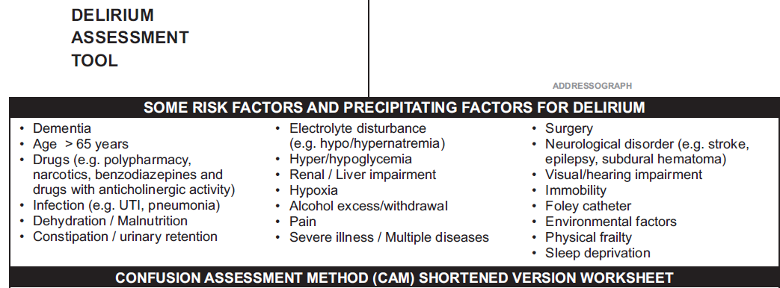
CAM Indication

Slide 19
Delirium- Case Study
Past medical history: MI (2010), HTN, Hyperlipidemia, Type II Diabetes mellitus, Hx. Of depression, HOH
Radiology report of right hip: Complete, comminuted, intertrochanteric fracture of the right hip. No other fractures were noted in the right leg.
Positive urine culture
BW: Hyponatremia (Na-126), hypokalemia (K-3.1), elevated creatinine (Cr-121), elevated leukocytes , abnormal blood glucose (14.9)

Slide 20
CAM Indication

Slide 21
Delirium- Case Study
1830hours:
Patient is agitated, disoriented , impulsive and constantly tries to pull on indwelling Foley & IV line
Pt is incoherent and rambling unclearly
Vitals: 158/96, HR- 108, T-37.8, RR-24, O2 sat: 94%

Slide 22
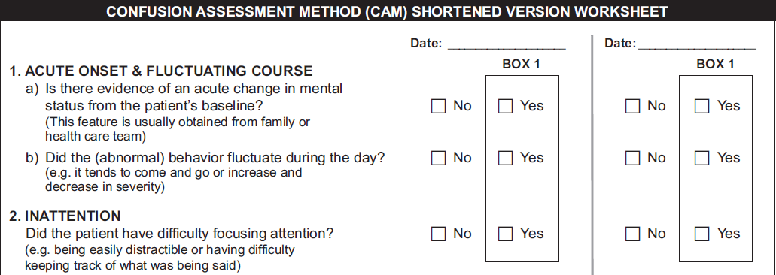
June 4th , 2015

Slide 23
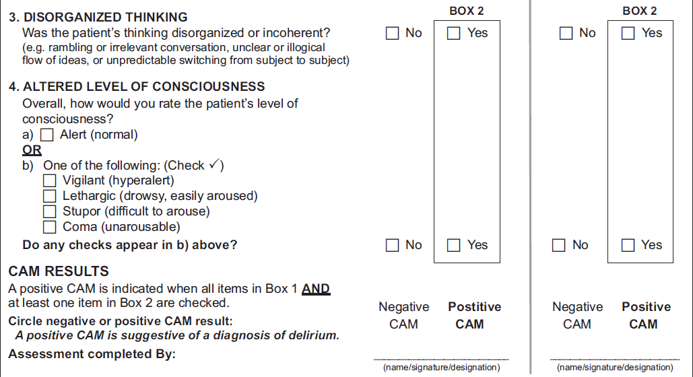
Hyper-active
vs
Hypo-active
Nurse, Nurse1

Slide 24
Results: CAM
Positive
Negative
Communicate
Consult: GEM nurse
Ongoing assessment
Treat the cause
Don’t’ forget: PAIN – 5th vital sign
Ongoing assessment
Q12hours
Or with change in cognitive status

Slide 25
DELIRIUM: Management
TREAT THE CAUSE
Eliminate medications that adversely affect mental state e.g. Ativan, Gravol.
Adequate hydration: observe patient at meal times
Correct sensory deficit- provide glasses and hearing aids
Orient and re-orient- approach in a calm reassuring manner
Speak slowly & clearly: use simple and short sentences

Slide 26
DELIRIUM: Management
TREAT THE CAUSE
Assess and manage pain.
Minimal use of indwelling Foley catheter
Physical restraints : LAST RESORT ONLY
Pharmacological intervention (Haldol) may be necessary for severe agitation –use drug in lowest possible dose for short timeframe.

Slide 27
References
Registered Nurses Association of Ontario. (2010a). Caregiving Strategies for Older Adults with Delirium, Dementia and Depression. Retrieved May 3rd 2015, from http://rnao.ca/sites/rnao-ca/files/Caregiving_Strategies_for_Older_Adults_with_Delirium_Dementia_and_Depression.pdf
Registered Nurses Association of Ontario. (2010b). Screening for Delirium, Dementia and Depression in Older Adults. Retrieved on May 3rd 2015, from http://rnao.ca/sites/rnao-ca/files/Screening_for_Delirium_Dementia_and_Depression_in_the_Older_Adult.pdf

